Slide 1
SMALL COMPILER
Submitted to: Mr. Vikas Wassan
Submitted by: Nitesh Kumar (16BCS1253)
Harpreet Kaur (16BCS1267)
Abhinay Shukla(16BCS1284)

Slide 2
COMPILER
A compiler translates the code written in one language to some other language without changing the meaning of the program. It is also expected that a compiler should make the target code efficient and optimized in terms of time and space.
Compiler design principles provide an in-depth view of translation and optimization process. Compiler design covers basic translation mechanism and error detection & recovery. It includes lexical, syntax, and semantic analysis as front end, and code generation and optimization as back-end.

Slide 3
COMPILER DESIGN
Language Processing System
Compilation Process
We have learnt that any computer system is made of hardware and software. The hardware understands a language, which humans cannot understand. So we write programs in high-level language, which is easier for us to understand and remember. These programs are then fed into a series of tools and OS components to get the desired code that can be used by the machine. This is known as Language Processing System.
The high-level language is converted into binary language in various phases. A compiler is a program that converts high-level language to assembly language. Similarly, an assembler is a program that converts the assembly language to machine-level language.
User writes a program in C language (high-level language).
The C compiler, compiles the program and translates it to assembly program (low-level language).
An assembler then translates the assembly program into machine code (object).
A linker tool is used to link all the parts of the program together for execution (executable machine code).

Slide 4
COMPILER DESIGN
A compiler can broadly be divided into two phases based on the way they compile.
Analysis Phase
Known as the front-end of the compiler, the analysis phase of the compiler reads the source program, divides it into core parts and then checks for lexical, grammar and syntax errors. The analysis phase generates an intermediate representation of the source program and symbol table, which should be fed to the Synthesis phase as input.
Synthesis Phase
Known as the back-end of the compiler, the synthesis phase generates the target program with the help of intermediate source code representation and symbol table.
A compiler can have many phases and passes.
Pass : A pass refers to the traversal of a compiler through the entire program.
Phase : A phase of a compiler is a distinguishable stage, which takes input from the previous stage, processes and yields output that can be used as input for the next stage. A pass can have more than one phase.
Architecture
Of
Compiler

Slide 5
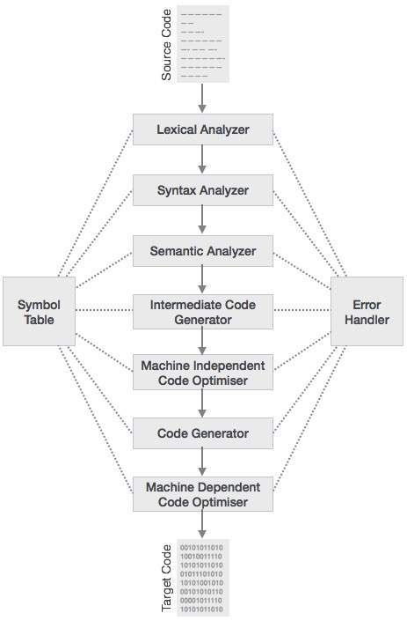
COMPILER DESIGN
Phases
Of
Compiler

Slide 6
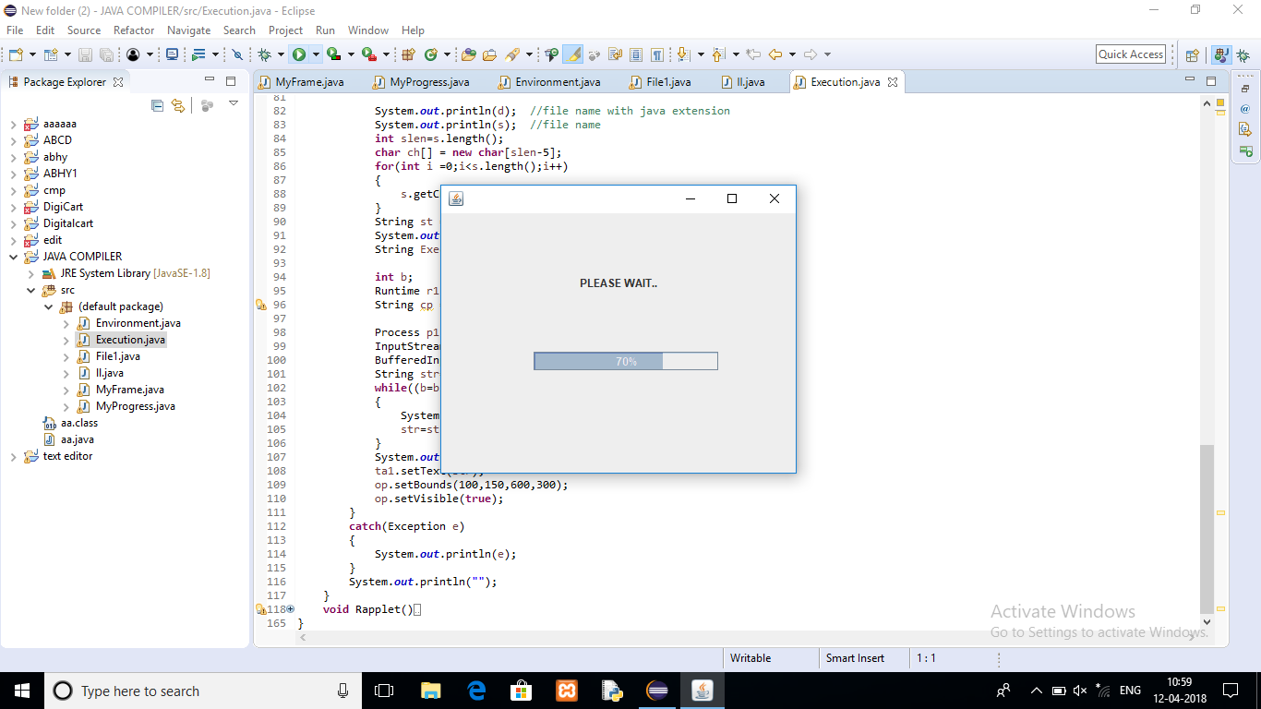
Working of a Compiler
1 .When the code starts executing

Slide 7
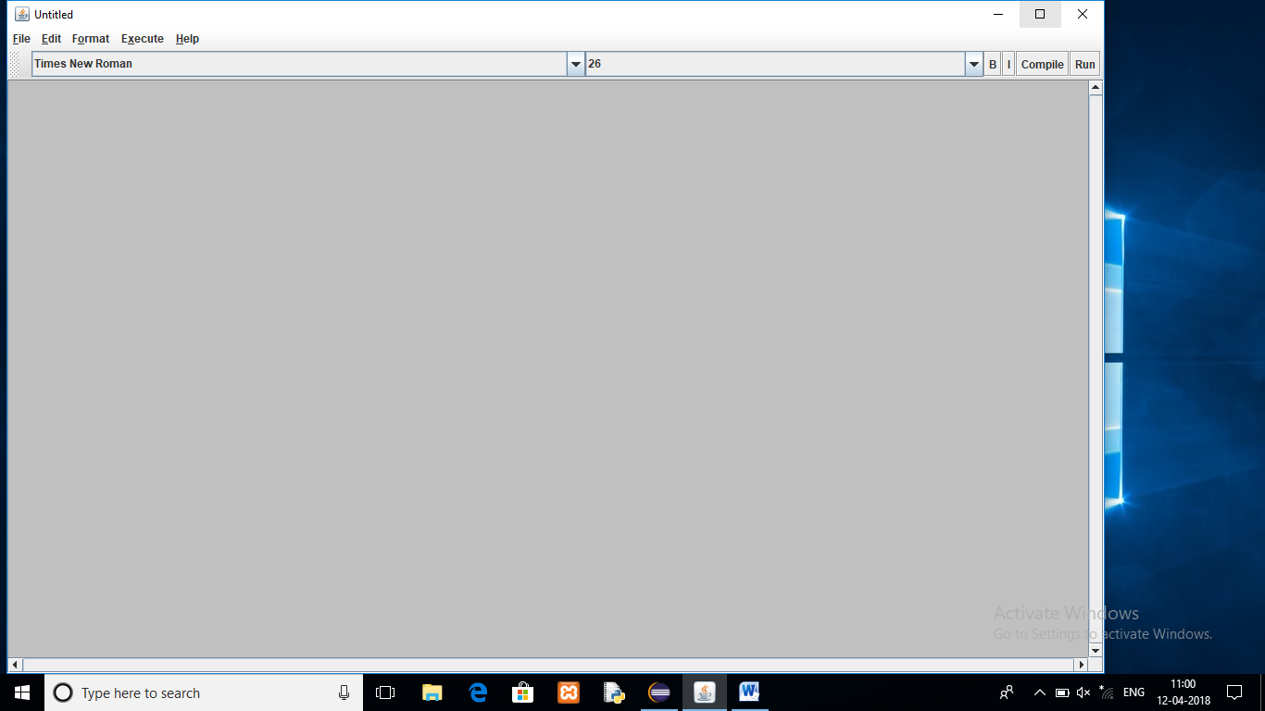
Working of a Compiler
2. First Window that appears after execution

Slide 8
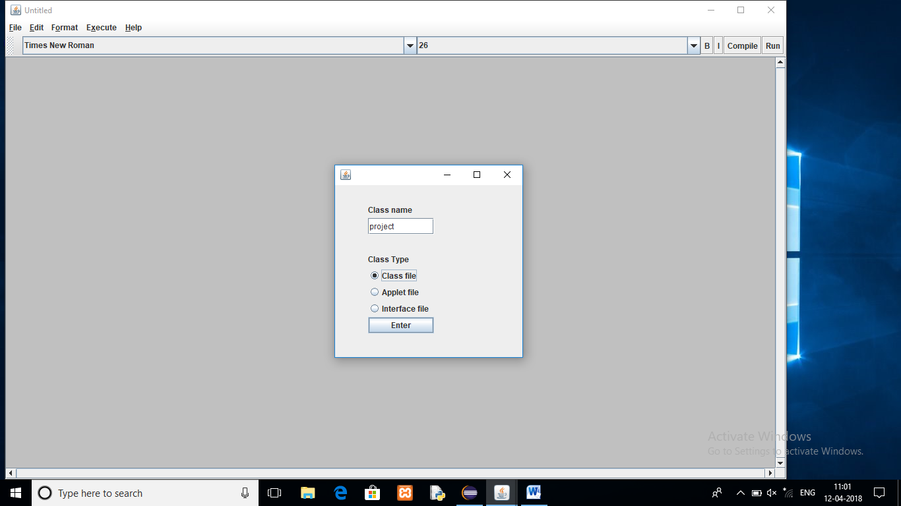
Working of a Compiler
3. Creating the class(while writing the code)

Slide 9
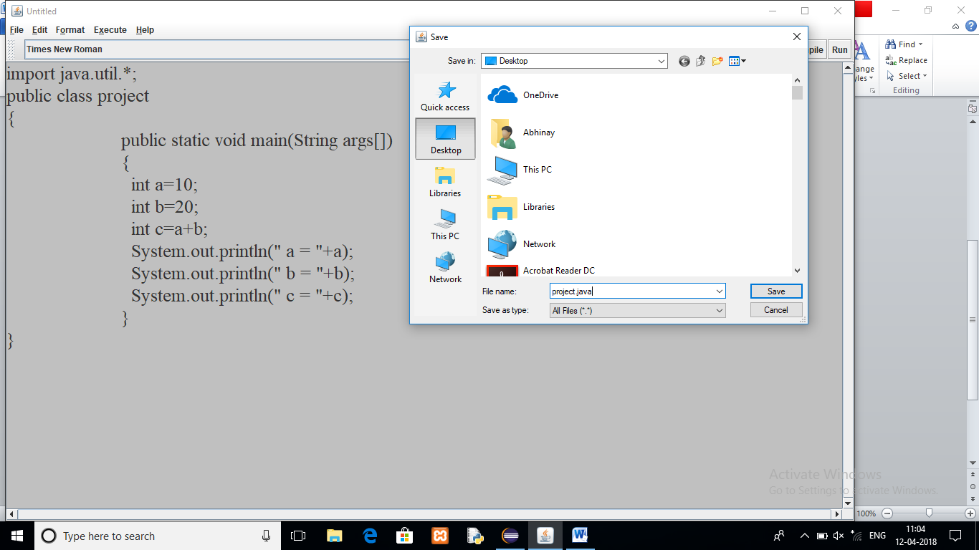
Working of a Compiler
4. Saving the code

Slide 10
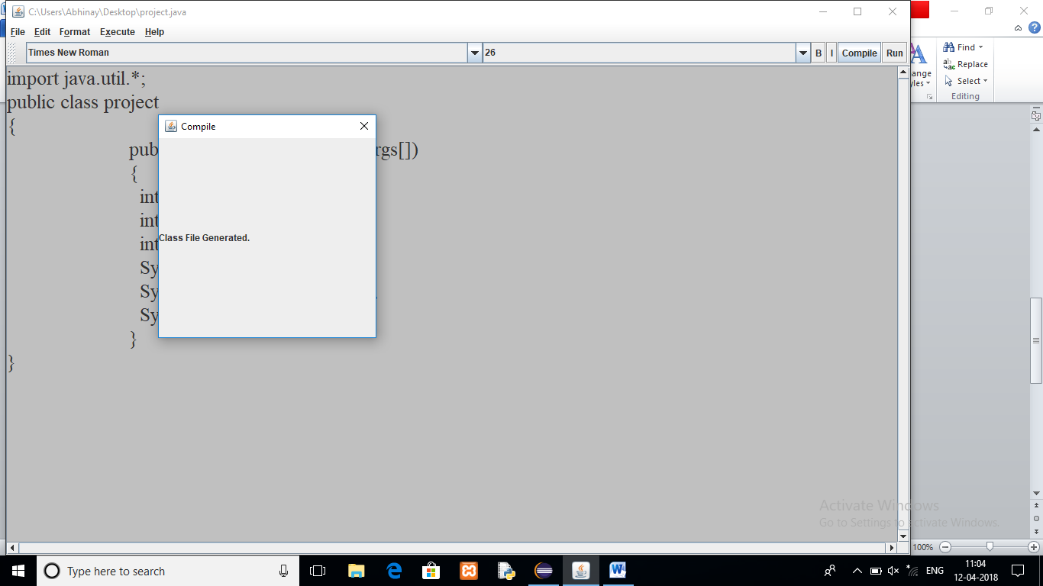
Working of a Compiler
5. On successful compilation of the code

Slide 11
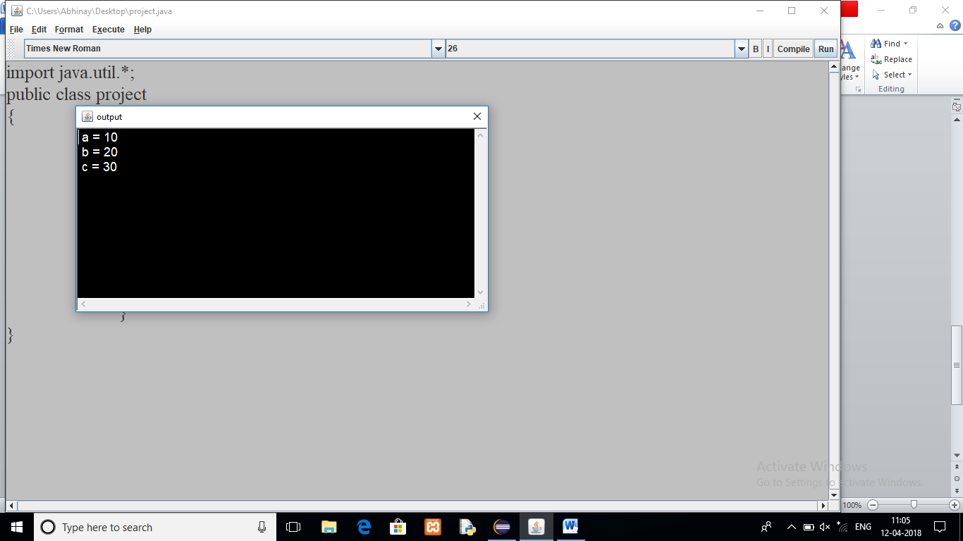
Working of a Compiler
6. Output of the Program

Slide 12
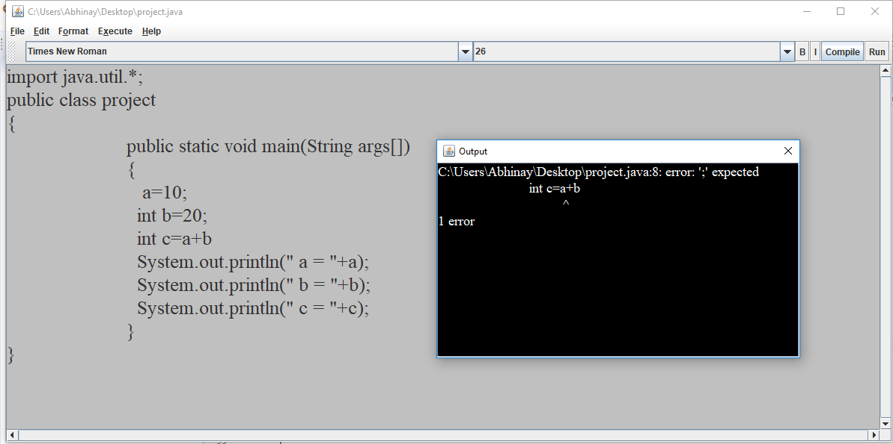
Working of a Compiler
7. When there is Error in the Code

Slide 13
THANK -YOU

